Slide 1
Deactivating Sample

Slide 2
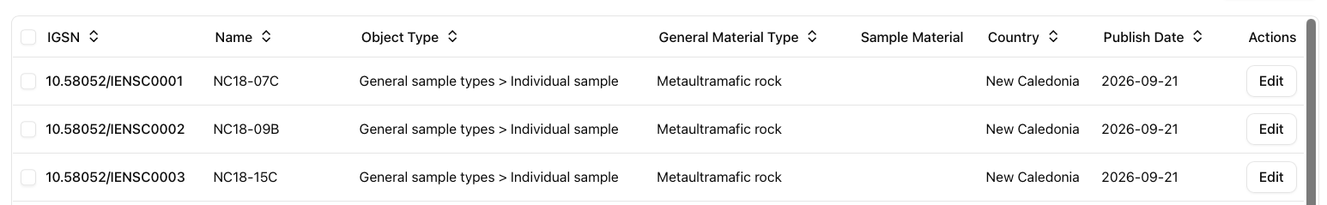
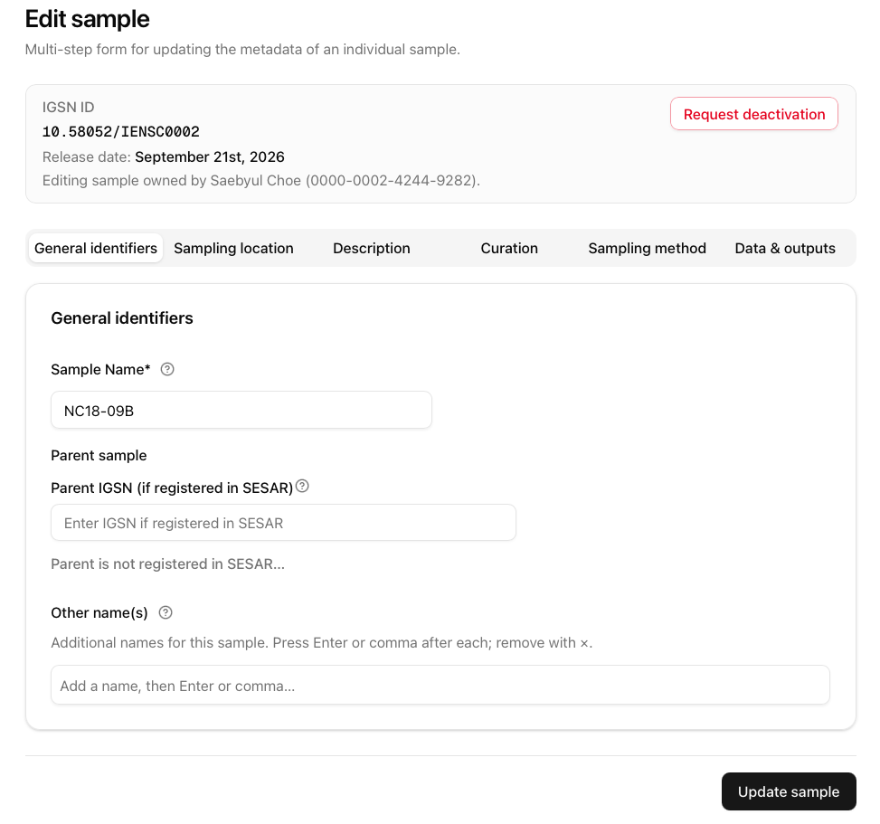
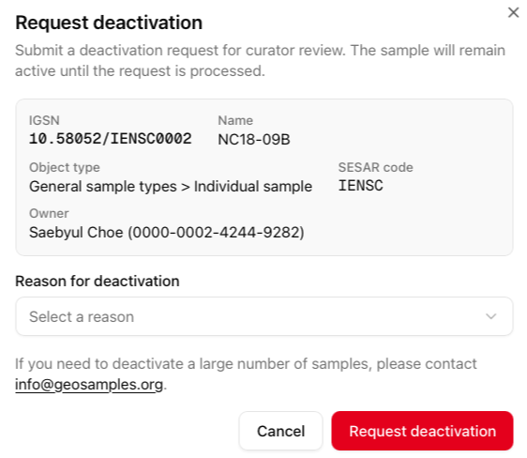
Editing Sample Record
Choose the sample you want to update metadata.
Scroll to the right and click Edit.
Select the metadata field(s), edit the content, click Update sample.
Update sample each time an edit is made. Edits are not automatically saved as you move through the metadata sections.
Request deactivation for registered samples.
Samples that are approved will no longer show up on your Samples page.

Slide 3
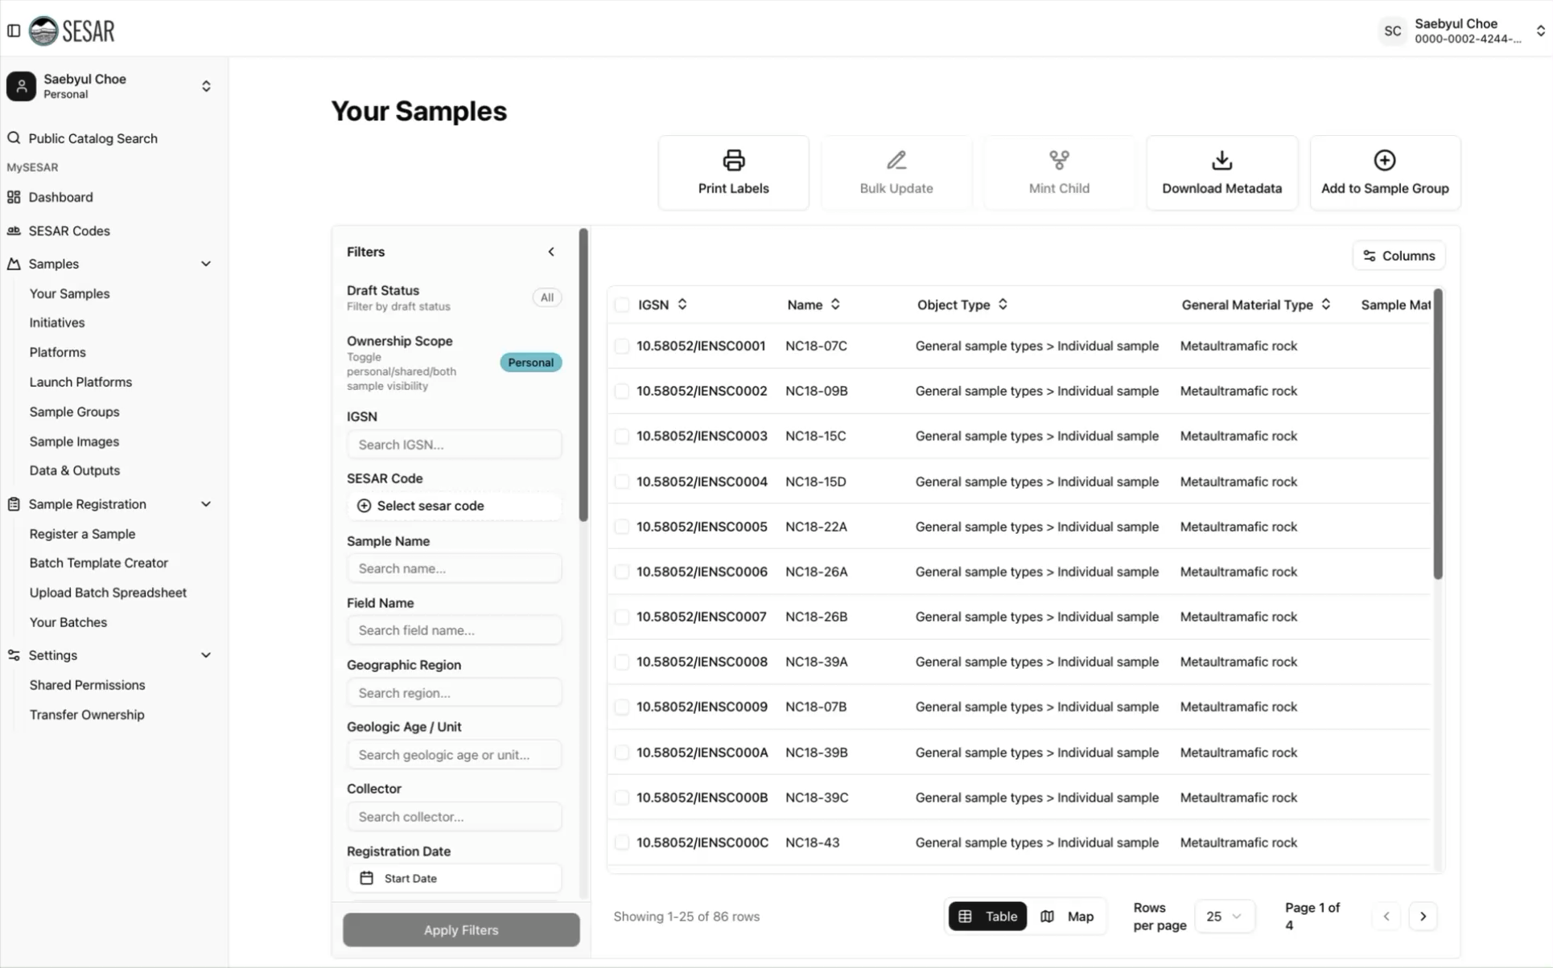
VIDEO Tutorial

